Slide 1
Ligand Substitution Reactions
kinetics

Slide 2
Water Exchange Reactions
n+
n+
²H₂O (l)
- OH₂
M^{n+} | log k (sec⁻¹)
Cr³⁺ | -6
V²⁺ | -2
Cr²⁺ | 9
Cu²⁺ | 9
SLOW
15 orders
of magnitude
increase!
FAST

Slide 3
Metal Complex Stability
π-acid
[W(CO)₆]
Very stable
d⁶ , large Δo ; colorless
d⁶ π-base
hν
N.R.
- CO
NEEDS LIGHT!
Why?

Slide 4
Metal Complex Stability
σ∗ with respect to
the ligands.
[W(CO)₆]
Energy Barrier Needs to be overcome!
e_{g}*
e_{g}*
E
hν
Δ_{o}
t_{2g}
t_{2g}
π-donating
Ligand Becomes Labilized!

Slide 5
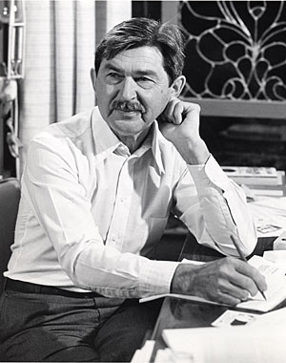
Ligand Substitution Reactions
Henry Taube: Nobel Prize 1983
“For his work on the mechanisms of electron transfer reactions, especially in metal complexes."
Jahn-Teller Distortion leads to fastest exchange of all 3d metals
“Inert”
“Labile”
Slow
Fast
:Rates of Ligand Subs. Rxns.
e_{g}*
e_{g}*
t_{2g}
t_{2g}
Cr³⁺, V²⁺ ; d^{2 and} d³
Cr²⁺; d⁴
Cu²⁺ ; d⁹

Slide 6
Dissociative Mechanism
TS₁
k₋₁
k₂
TS₂
the second ligand is easier to remove, since the ML₅ intermediate is Jahn-Teller distorted.
E
k₁
k₋₂
ML₅ + X + Y
(intermediate)
ML₅X + Y
ML₅Y + X
Reaction Coordinate
k₁ : forward reaction
k₋₁ : reverse
k₂ (ML₅ + Y)
k₋₂ : reverse
Limiting Case true when [Y] is large
If k₂[Y] >> k₋₁[X]
i.e. Y is solvent
And assuming complete reaction
k₋₂[ML₅Y][X] is negligible
Reaction Rate = k₁[ML₅X][Y] = k_{obs}[ML₅X]
pseudo-first order conditions
constant

Slide 7
Dissociative Mechanism
[ML₅Y]
Conc.
[ML₅X]
time
No buildup of intermediates : Steady State Approximation

Slide 8
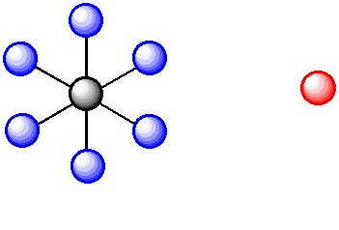
Dissociative Mechanism

Slide 9
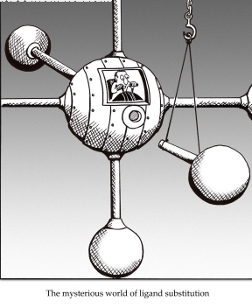
Measuring the Rates
“inert” complexes have t_{1/2} > 1 min. Can use class techniques, such as pH, UV-vis
“labile” complexes have t_{1/2} between 1 ms and 1 min. Need fast spectral techniques

Slide 10
Ligand Substitution at D_{4h} Centers
Common elements that make 4-coordinate complexes:
Mn, Ni, Cu, Rh, Pd, Pt, Ir, Pt, Au, Ag, Cl, Br, I, Xe
In particular: Ni(II), Rh(I), Pd(II), Ir(I), Pt(II), Au(III) , d⁸ configs.
ML₃X + Y
ML₃Y + X
second order kinetics depends on the nature of both the leaving group X and the entering group Y.
Steric crowding slows down the reaction: Evidence for an associative mechanism.

Slide 11
Mechanism for Square Planar Ligand Substitution
ML₃X + Y
ML₃Y + X
For square planar: BOTH bond-breaking and bond making are important in the reaction mechanism (i.e. an associative mechanism).
Stereospecific – X (leaving group) is trans to L₂ and so is Y (entering group)

Slide 12
Mechanism for Square Planar Ligand Substitution
ML₃X + Y
ML₃Y + X
Initial attack by the entering group at a square planar Pt(II) centre is from above or below the plane. Nucleophile Y then coordinates to give a trigonal bipyramidal intermediate species which loses X with retention of stereochemistry)

Slide 13
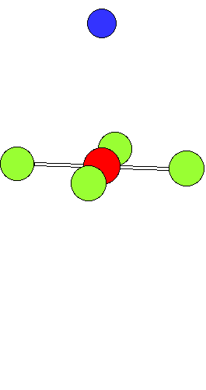
Associative Mechanism at D_{4h} Centers
ML₃X + Y
ML₃Y + X
[PtCl₄]²⁻ + NH₃ [PtCl₃(NH₃)]⁻ + Cl⁻
The incoming ligand (colored blue) approaches a vacant axial site of the squareplanar complex to form a square pyramidal intermediate (or transition state).
Intramolecular rearrangement via a trigonal
bipyramid generates a different square
pyramidal structure with the incoming ligand
now in the basal plane. (This motion is closely
related to Berry Pseudorotation).
The reaction is completed by the leaving
group departing from an axial site with
the stereochemistry being retained during the substitution process.

Slide 14
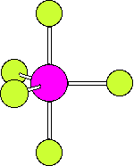
Berry pseudorotation
Occurs in, for example, Fe(CO)₅, for which ¹³C NMR spectroscopy cannot
distinguish axial and equatorial CO environments, due to the rapid interchange.
The same process can occur in main group compounds like PF₅.
a trigonal bipyramidal molecule ML₅ undergoing Berry pseudorotation.

Slide 15
Square Planar Substitution Reactions
Examples:
Factors Which Affect The Rate Of Substitution
i). Role of the entering group
ii). Role of The leaving group
iii). Nature of the other ligands in the complex
iv). Effect of the metal center

Slide 16
i). Role of the Entering Group
• The rate of substitution is proportional to the nucleophilicity of entering group
• i.e. for most reactions of Pt(II), the rate constant increases in the order:
H₂O <NH₃ = py < Br⁻ < I⁻ < CN⁻
• The ordering is consistent with Pt(II) being a soft metal center.
ii). The Role Of The Leaving Group
[Pt(dien)X]⁺ + py [Pt(dien)(py)]⁺ + X⁻
In H₂O at 25ºC the sequence of lability is:H₂O > Cl⁻ >Br ⁻ > I⁻ > N₃⁻ > SCN⁻ > NO₂⁻ > CN⁻
a spread of over 10⁶ in rate across series.

Slide 17
iii). The Nature of other Ligands in the Complex
3. The trans effect
The trans effect is best defined as the effect of a coordinated ligand upon the
rate of substitution of ligands opposite to it.
Or The ability of a ligand in a square planar complex to direct the replacement if
the ligand trans to it.
The trans effect is given as the following series:
CN⁻ > NO₂⁻ > I- = SCN⁻ > Br⁻ > Cl⁻ > py > NH₃ > H₂O

Slide 18
3. The trans effect

Slide 19
Depends on order in which the reagents are added as to which geometric isomer
is formed so has uses for devising synthesis of Pt(II) complexes.
e.g. consider the preparation of cis and trans PtCl₂I(py) from PtCl₄ ²⁻, I⁻ and py.

Slide 20
Polarization Theory
Explains the kinetic trans effect in square planar Pt(II) complexes

Slide 21
Polarization Theory
Support for this theory is demonstrated by looking at the trans directing series.
CN⁻ > NO₂⁻ > I- = SCN⁻ > Br⁻ > Cl⁻ > py > NH₃ > H₂O
The more polarizable ligands such as SCN-, and I- and the ligands containing π-clouds e.g. CN- are high in the series
Less polarizable ligands such as ammonia or water are lower in the series.
Additional support comes from the observation that Pt(II) complexes demonstrate a more pronounced trans effect than those of the less polarizable Pd(II) and Ni(II) cations.

Slide 22
Other contributing factors to the trans-effect
In the trigonal plane of the 5-coordinate transition state or intermediate, a π-
bonding interaction can occur between a metal d-orbital (e.g. d_{xy}) and suitable
orbitals (p atomic orbitals, or molecular orbitals of π-symmetry) of ligand L₂ (the
ligand trans to the leaving group) and Y (the entering group).
These 3 ligands and the metal center can communicate electronically through π-
bonding only if they all lie in the same plane in the transition state or
intermediate.
This implies the 5-coordinate species must be trigonal pyramidal.

Slide 23
Rules:
It is easier to replace Cl⁻ than most other ligands.
If you want to displace some other ligands with Cl⁻ you must use a huge excess of Cl⁻
If there is more than one possibility for replacing the Cl⁻, the one that is replaced is the one trans to the ligand higher in the series.
Part of the general order for the trans effect (the ability of ligands to direct trans-substitution) is shown below:
CN⁻ > NO₂⁻ > I⁻ = SCN⁻ > Br⁻ > Cl⁻ > py > NH₃ > H₂O
A strong π-acceptor e.g. CN⁻ will stabilize the transition state by accepting electron density that the incoming nucleophile donates to the metal center, and will thereby facilitate substitution at the site trans to it.

Slide 24
iv). Effect of the Metal Center
The order of reactivity of a series of isovalent ions is: Ni(II) > Pd(II) >> Pt(II)
This order of reactivity is the same order as the tendency to form 5-coordinate
complexes.
More ready the formation of a 5-coordinate intermediate complex, the greater
the stabilization of the transition state and so the greater the bimolecular rate
enhancement.
M (II) Ni k = 33 M⁻¹ sec⁻¹
Pd k = 0.58 M⁻¹ sec⁻¹
Pt k = 6.7 x 10⁻⁶ M⁻¹ sec⁻¹

